Slide 1

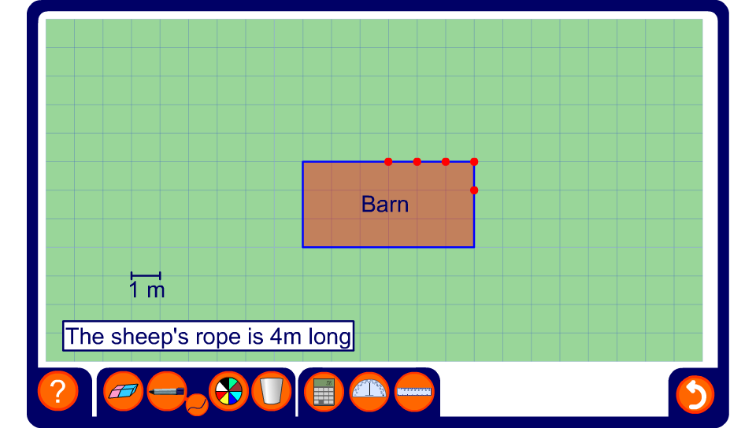


Grazing sheep
Notes:
Explain that the sheep is tethered to the point P on the edge of the barn by a rope that is 4 m long. Ask pupils to describe the region of grass that the sheep can graze.
Press the play button to illustrate the region on the board and show the radius of each arc using the straight pen tool. Explain that as the sheep gets to the corners there is only 1 m of rope left and so the radius of the sector at that corner is 1 m.
Change the point from which the rope is attached. Repeat the activity to investigate which position would give the sheep the largest grazing area.

